Slide 1

DA-100 Analyzing Data with Power BI

Slide 2
Module 1: Getting Started with Microsoft Data Analytics

Slide 3
Learning Objectives
You will learn the following concepts:
Data Analysis
Getting Started with Power BI

Slide 4
Lesson 1: Data Analytics and Microsoft
Notes:
.

Slide 5
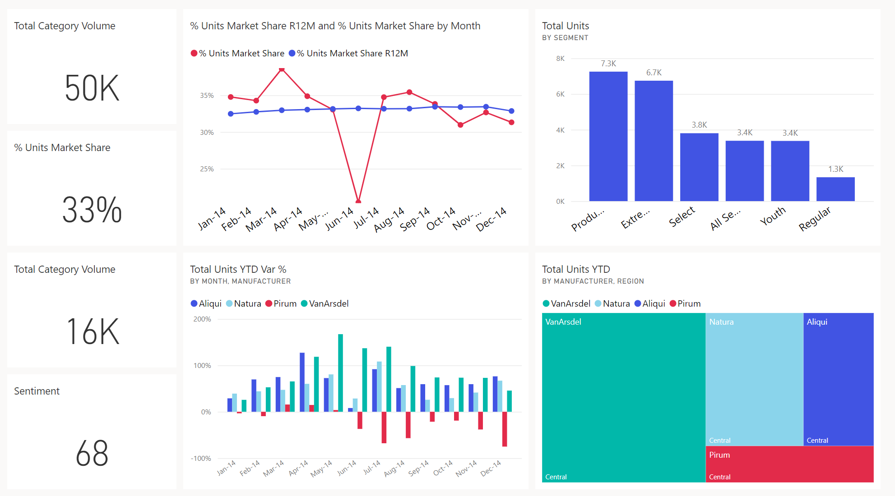



















Introduction
Data and information is the most strategic business asset.

Slide 6
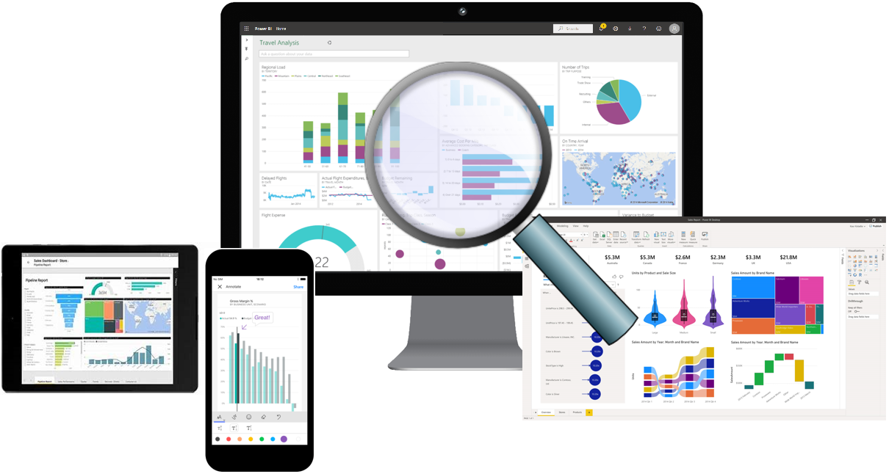
Overview of Data Analysis
Data Analysis is telling a story with data.
Five categories of analytics:
Descriptive
Diagnostic
Predictive
Prescriptive
Cognitive

Slide 7









Roles in Data
Business
Analyst
Data
Analyst
Data
Engineer
Data
Scientist
Database
Administrator
DA-100
DP-203
DP-100
DP-300

Slide 8

Tasks of a Data Analyst
Prepare
Model
Visualize
Analyze
Manage

Slide 9
Review Questions
Q01 – Which data role enables advanced analytics capabilities through reports and visualizations?
A01 – Data Analyst
Q02 – Which data analyst task has critical performance impact on reporting and data analysis?
A02 – Model
Q03 – What is a key benefit of data analysis?
A03 – Informed business decisions.

Slide 10
Lesson 2: Getting Started with Power BI

Slide 11
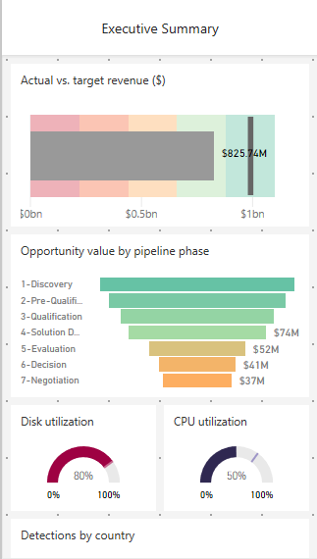
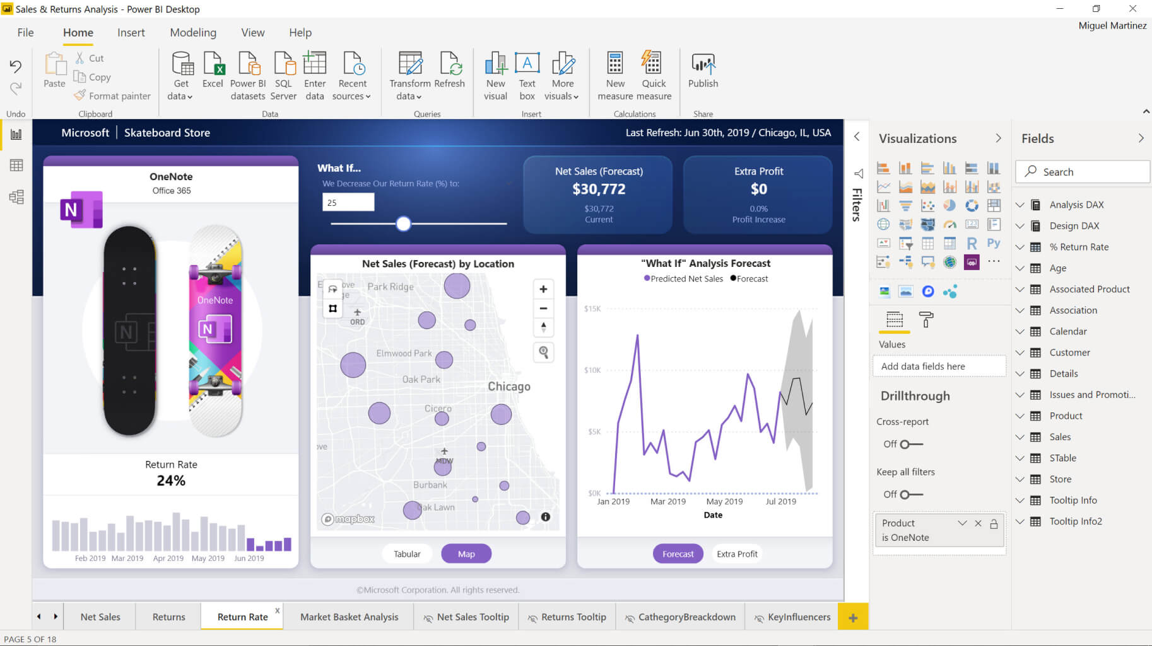
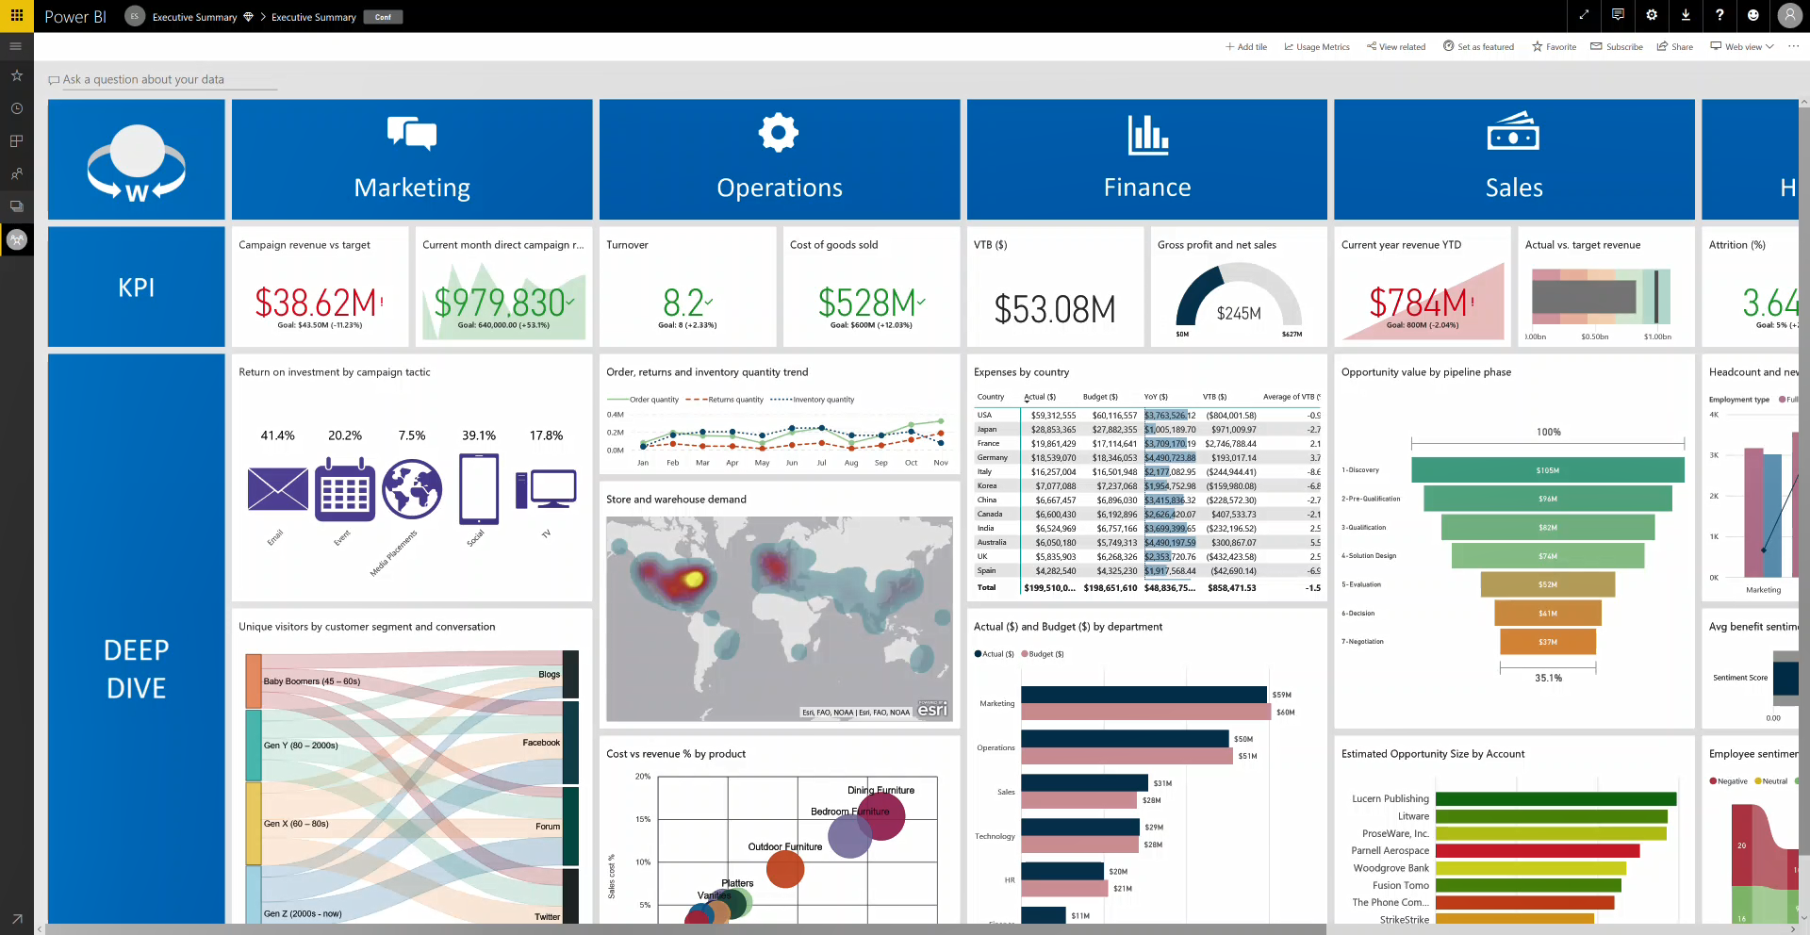
Introduction to Power BI
Power BI: A collection of software, services, apps, and connectors.

Slide 12


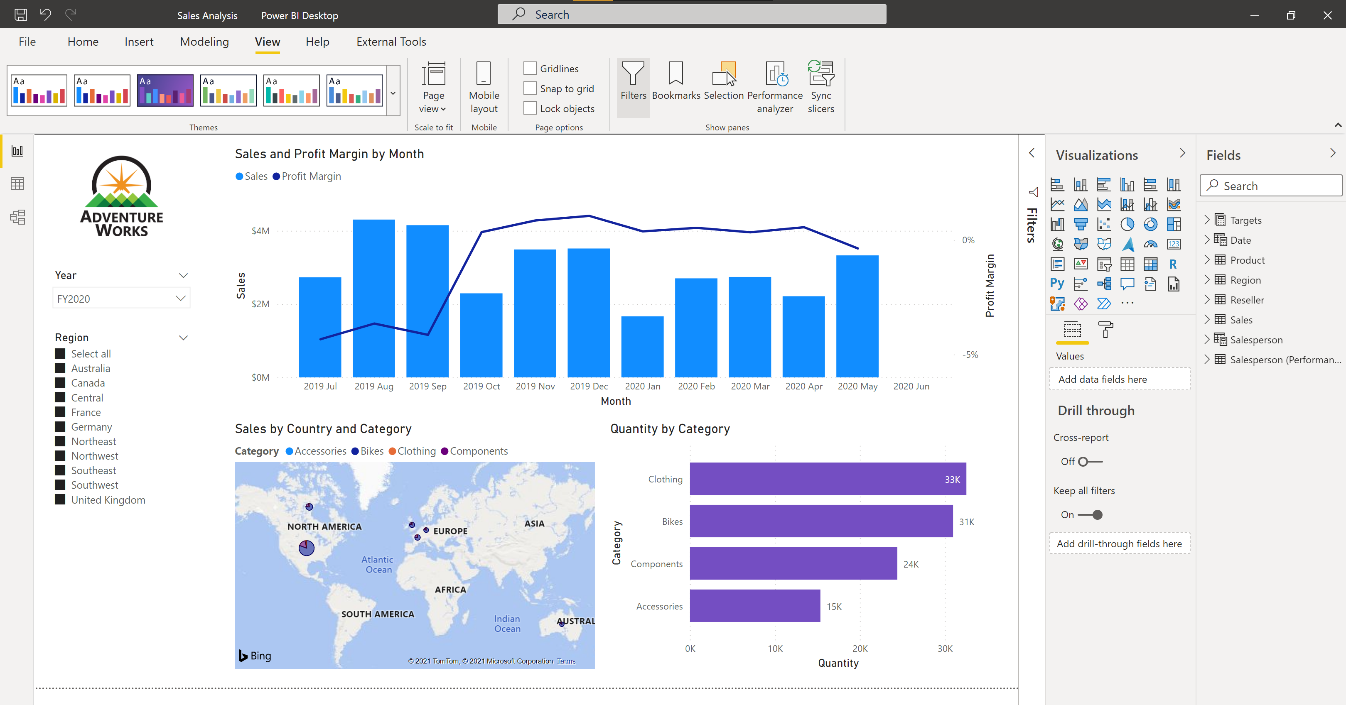




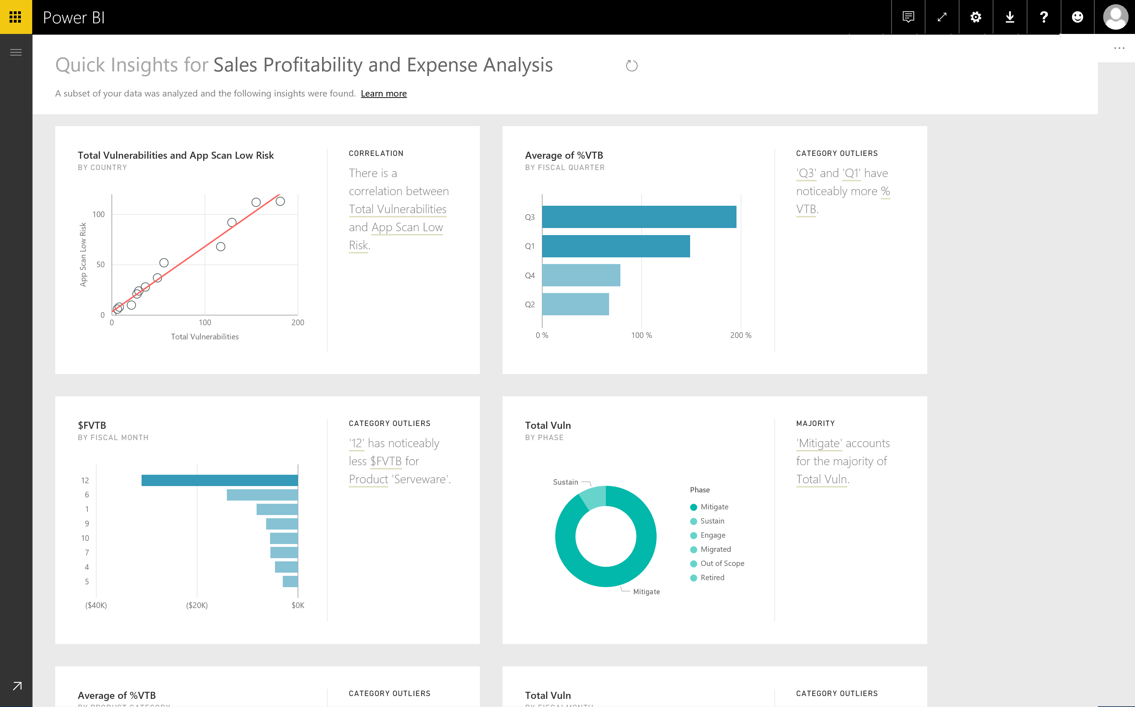
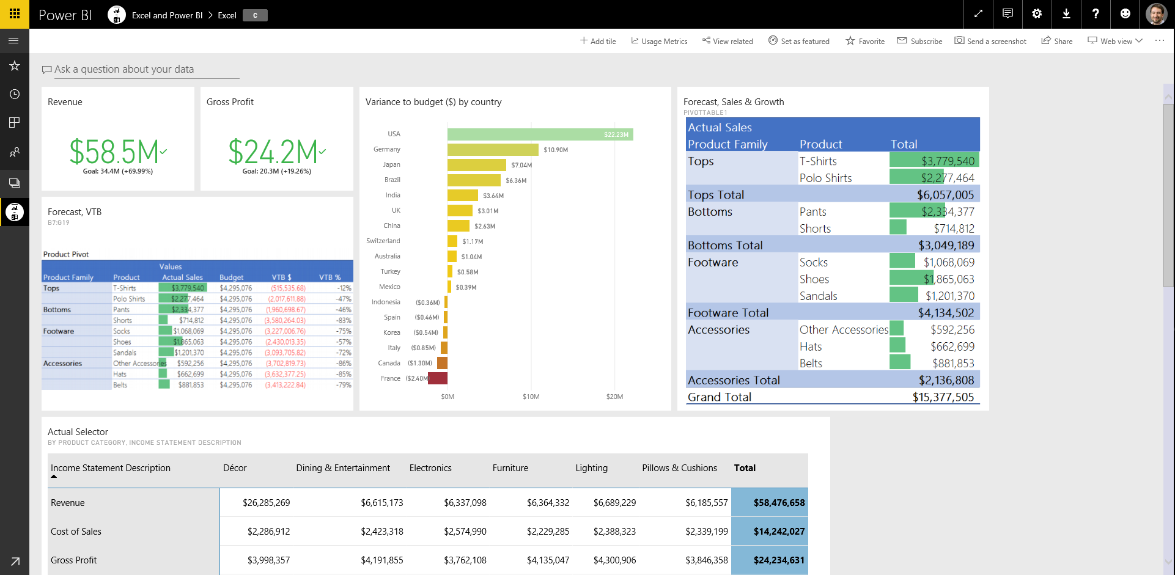
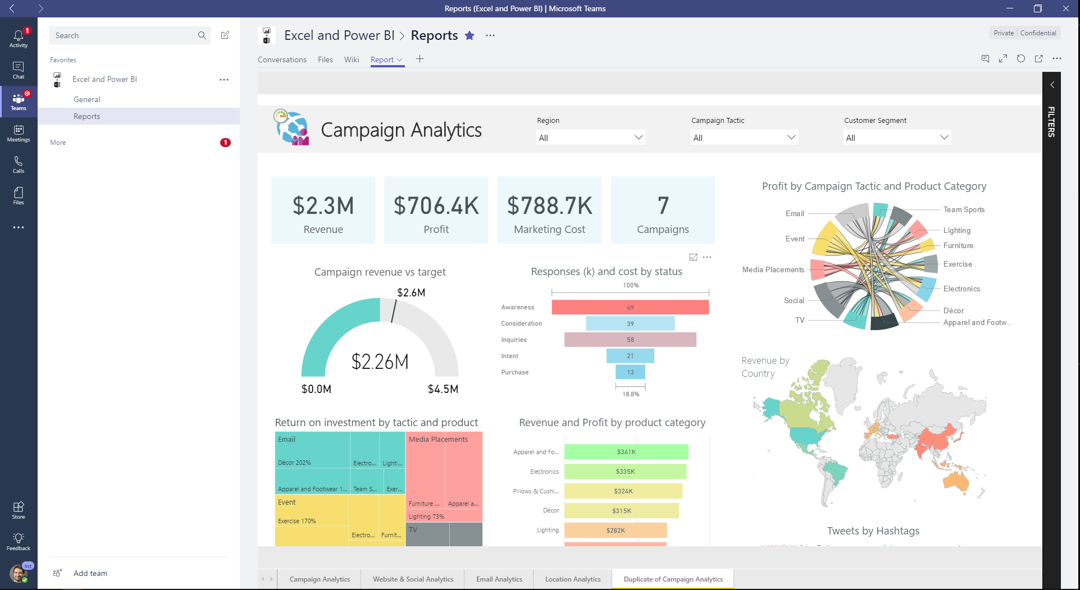
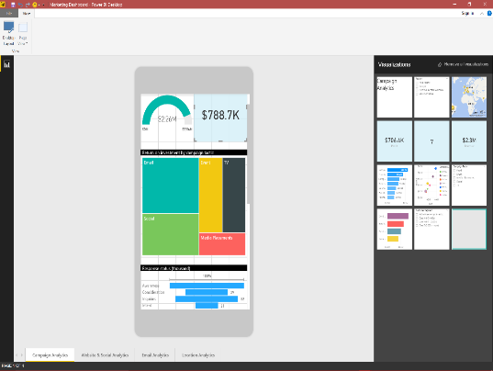

Use Power BI

Slide 13
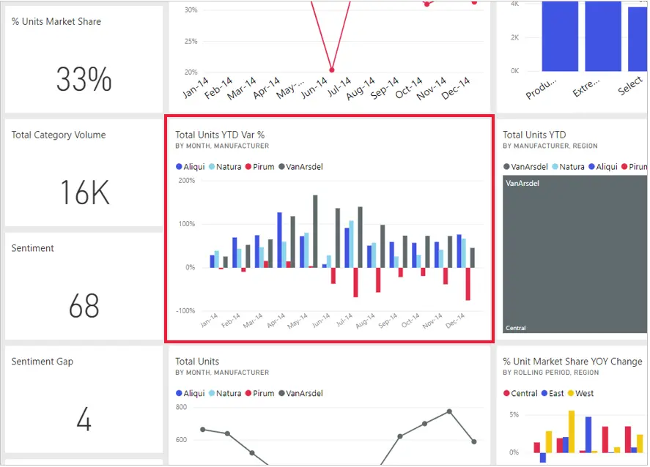
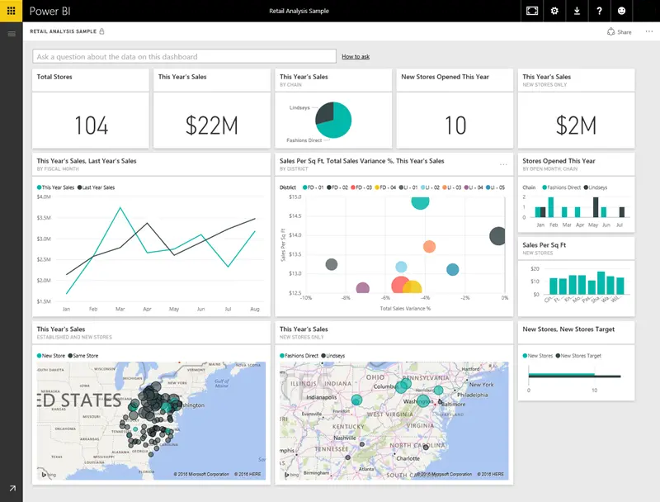
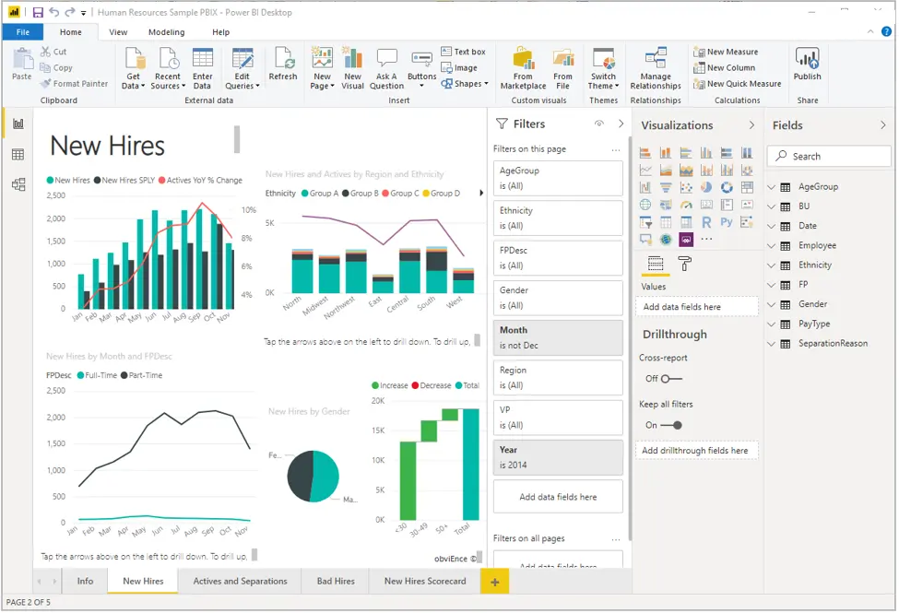
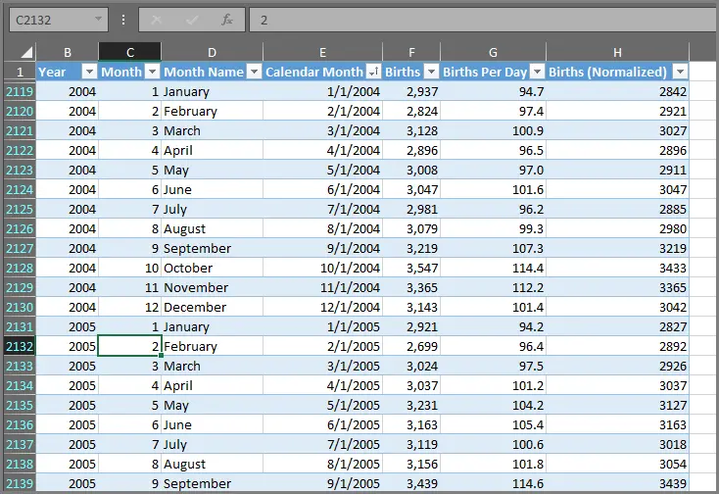
Building Blocks of Power BI

Slide 14
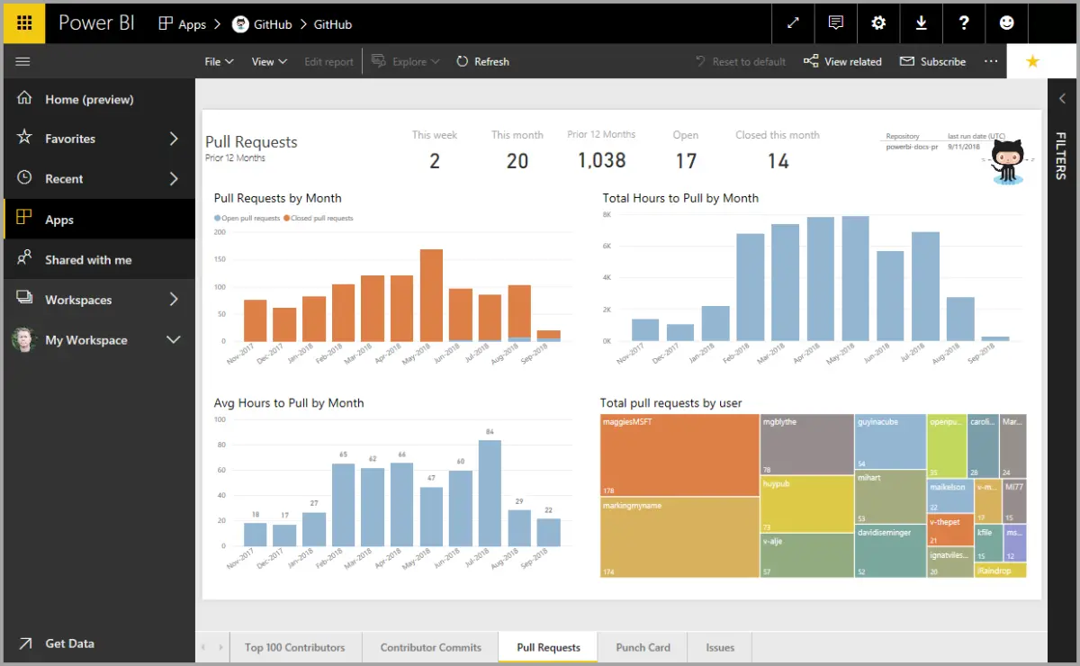
Touring and Using Power BI

Slide 15
Review Questions (2)
Q01 – What are the building blocks of Power BI?
A01 – Visualizations, Datasets, Reports, Dashboards, and Tiles
Q02 – What is the common flow of activity in Power BI?
A02 – Bring data into Power BI Desktop and create a report, share it to the Power BI service, view and interact with reports and dashboards.
Q03 – A collection of ready-made visuals, pre-arranged in dashboards and reports is called what?
A03 – An App

Slide 16
Module Overview
We covered the following concepts:
Data Analysis
How to get started with Power BI

